Slide 1
Comparative Analysis of Machine Learning Models for Predicting Patient Readmissions: A Study on Precision, Recall, and Discriminatory Performance
Akshda Shandilya
BUSI973: Independent Study
Dr. J. D. Jayaraman

Slide 2
LIST OF CONTENTS
INTRODUCTION
LITERATURE REVIEW
RESEARCH QUESTION AND HYPOTHESIS
METHODOLOGY
DATA ACQUISITION
VARIABLE DESCRIPTION
EXPLORATORY DATA ANALYSIS
IDENTIFYING VARIABLE MODELS FOR ANALYSIS
DATA MODELING
BUILDING THE MODEL
OLS REGRESSION
RANDOM FOREST CLASSIFICATION
LOGISTIC REGRESSION
SUPPORT VECTOR MACHINE
GRADIENT BOOSTING
GAUSSIAN NAIVE BAYES
K - NEAREST NEIGHBORS
NEURAL NETWORKS
RESULTS
CONCLUSION
REFERENCES

Slide 3
INTRODUCTION

Slide 4
INTRODUCTION
Hospital readmission reduction is vital globally for better patient outcomes, resource optimization, and cost minimization.
Machine learning models offer accurate readmission prediction and timely interventions, gaining attention in healthcare.
The study assesses multiple machine-learning models for predicting hospital readmissions.
Readmissions, impacting patients and healthcare systems, necessitate robust predictive models for high-risk patient identification.
Diverse algorithms (e.g., decision trees, random forests, SVM, logistic regression) and patient-specific features (e.g., demographics, medical history) are considered using anonymized patient records for accurate predictions and proactive patient care.
Notes:
Global Significance of Readmission Reduction: Hospital readmission reduction globally is crucial for improving patient outcomes, optimizing resource utilization, and minimizing costs. Enhancing patient well-being, efficient resource management, and cost-effectiveness are driving factors.
Machine Learning's Role in Readmission Prediction: Machine learning models have gained traction in healthcare due to their ability to accurately predict readmission rates and enable timely interventions.These models are garnering attention as valuable tools for proactive patient care.
Assessment of Machine-Learning Models: The research centers on evaluating multiple machine-learning models for their predictive capabilities in hospital readmissions. Decision trees, random forests, SVM, and logistic regression are among the diverse algorithms that were used for this study.
Readmissions and the Need for Robust Predictive Models: Readmissions not only affect patients' well-being but also exert a significant burden on healthcare systems. To address this, robust predictive models are required to identify high-risk patients and allocate resources effectively.
Diverse Algorithms and Patient-Specific Features: this study considers an array of algorithms and patient-specific features for the same. Utilizing anonymized patient records, these variables enable precise predictions and proactive patient care.

Slide 5
LITERATURE REVIEW
Lin et al. (2019): ICU Readmissions
Developed predictive model using LSTM-based neural networks.
Utilized ICU patient records: demographics, medical history, vital signs, lab results.
LSTM outperformed traditional methods.
Key factors: patient age, ICU stay duration, specific lab measurements.
Potential for proactive interventions in ICU readmissions.
Yujuan Shang et al.: Diabetic Patients
Built 30-day readmission risk model for diabetics with machine learning.
Employed Health Facts Database data.
Random forest (RF) excelled over naive Bayes, tree ensemble models.
Influential factors: admission times, age, diagnosis, emergencies, sex.
Insights for interventions, especially in elderly cases.
Riester et al.: Heart Failure Readmissions
Introduced ToPP-HF tool for 30-day unplanned readmissions in heart failure patients.
13 variables categorized patients for interventions.
Strong validation results suggest clinical potential.
Urology Study: XGBoost Model
Focus on 30-day unplanned readmissions in urology using machine learning.
XGBoost model showcased predictive superiority over regressions.
Wide-ranging features: patient characteristics, lab results, etc.
Acknowledged data quality issues, subjective feature selection.
Need for exploring real-world implications.
Common Insights from Studies
Machine learning's promise in readmission risk prediction.
Personalized insights for patient care.
Challenges: data quality, model generalizability, interpretability.
Emphasis on practical and reliable tools for real-world healthcare.
Notes:
Studis by Cox et al (2022), Lin et al. (2019), Shang et al. (2021), Riester et al. (2021), kwetzer (2020), Matheny et ap (2021), Saha et al (2021) and Welvaars et al (2023), all address the question of prediction of readmission of patients in hospitals using different variables and machine learning models. However, most of these stuf focus on either one medical specialty or a 30-day readmission time frame.
Collectively, these studies emphasize machine learning's promise in readmission risk prediction, offering personalized insights for patient care. Challenges like data quality, model generalizability, and interpretability are acknowledged, underlining the need for practical and reliable predictive tools in real-world healthcare settings.

Slide 6
RESEARCH QUESTION
Research Question:
Can a comprehensive analysis of demographic, hospital stay, clinical, medical coding, treatment, and medication variables accurately predict patient readmission likelihood in a hospital setting?
Hypothesis:
By integrating and analyzing a wide range of variables encompassing demographics, hospital stay details, clinical indicators, medical coding, treatment, and medication data.
Anticipate effective prediction of patient readmission probabilities using machine learning models.
Expect one machine learning algorithm to outperform others in predictive accuracy and generalizability.
Resulting tool can proactively address patient readmission risks, enhancing overall patient outcomes for healthcare providers.
Notes:
Research Question: Can a comprehensive analysis of demographic, hospital stay, clinical, medical coding, treatment, and medication variables provide an accurate prediction of patient readmission likelihood in a hospital setting? Furthermore, which machine learning model demonstrates the highest predictive accuracy and reliability?
Hypothesis: We propose that through the integration and analysis of a diverse range of variables spanning demographics, hospital stay details, clinical indicators, medical coding, treatment, and medication data, machine learning models can effectively predict patient readmission probabilities. We anticipate that among the tested machine learning algorithms, one will stand out with superior predictive accuracy and generalizability. This will offer healthcare providers a valuable tool to proactively manage patient readmission risks, ultimately leading to improved patient outcomes.

Slide 7
METHODOLOGY

Slide 8
DATA AND VARIABLES
Medical data acquisition complex due to HIPAA regulations and patient privacy concerns.
Scarce availability of openly accessible medical datasets.
Kaggle dataset used, de-identified to protect privacy, containing 65 variables from 25,000 patients.
Valuable resource for training and evaluating predictive models for patient readmissions.
Researchers must acknowledge limitations, potential biases, and contextualize findings for accurate interpretation.
Age Variables: Binary indicators for different age groups.
Race Variables: Binary indicators for race.
Hospital Variables: Hospital duration, lab procedures, non-lab procedures, medications, outpatient/inpatient visits.
Payer Variables: Binary indicators for payment methods.
Medical Specialty Variables: Binary indicators for physician specialization.
Diagnosis Variables: Binary indicators for specific diagnoses.
Medicine Variables: Binary indicators for medication prescriptions.
Other Variables: Binary indicators for medication changes, diabetes medication prescription.
Derived Variables: Aggregated indicators for age, race, payer, medical specialty, diagnosis, medicines, glucose tests, insulin, and medication changes.
Notes:
Age Variables included Binary indicators representing different age groups (40s, 50s, 60s, 70s, 80s-90s). Insights into age-related health trends and readmission rates.
Race Variables: Binary indicators for Caucasian and African American races.no other race was considered for this study.
Hospital Variables included Details about hospital stay, treatment, procedures, medications, outpatient/inpatient visits were mentioned in this. Patterns in healthcare utilization and treatment intensity.
Payer Variables were Binary indicators for insurance types (e.g., Medicare, Managed Care) and payment methods. Insights into insurance coverage influence on healthcare utilization and readmission.
Medical Specialty Variables were Binary indicators for physician specialization (e.g., Internal Medicine, Cardiolog).
Diagnosis and Medicine Variables: Binary indicators for specific diagnoses (e.g., heart failure, diabetes) and medication prescriptions. Identifying prevalent health conditions, medication prevalence, and impact on readmission.
Other Variables: Binary indicators for medication changes and diabetes medication prescription. Reflecting patient management and potential readmission effects.
Derived Variables were then Created by aggregating binary indicators to provide a broader perspective.
'total_age' for age, 'total_race' for race, 'total_payer' for payment method, 'total_medical_specialty' for all medical specialties, 'total_diagnosis' combining different diagnoses, 'total_meds' indicating all medications and 'total_glucose_tests' specifying diabetes tests, 'total_insulin' identifying medications for diabetes and 'total_change_diabetesMed' combining the last two.
This enabled comprehensive exploration, capturing patient characteristics and behaviors, potentially enhancing modeling.

Slide 9
EXPLORATORY DATA ANALYSIS
Step 1: Initial Data Exploration
Step 2: Handling Missing Values
Step 3: Exploring Numerical Variables
Step 4: Categorical Variables Analysis
Step 5: Analyzing the Target Variable
Step 6: In-depth Variable Analysis
Step 7: Creating Derivative Variables
Step 8: EDA Findings and Modeling Choices
Notes:
Step 1: Initial Data Exploration:
Examining dataset structure, column names, rows, and columns using info(), head(5), shape, and column functions.
Step 2: Handling Missing Values:
Identifying missing values represented as '?' and 'NaN' using isnull().sum().sum().
Total columns with missing values identified for subsequent handling.
Step 3: Exploring Numerical Variables:
histograms were created to understand numerical feature distribution.
correlation heatmap was generated to identify feature correlations.
Pairplot analysis was done to visualize relationships and potential correlations.
Step 4: Categorical Variables Analysis:
Count plots were created for categorical variables to visualize category frequencies. Cross-tabulations and heatmaps were crea to explore relationships with the target variable.
Step 5: Analyzing the Target Variable:
Count plot to visualize distribution of 'readmitted' target variable was created across all variables.
This provided Insight into class imbalance and proportion of readmitted patients.
Step 6: In-depth Variable Analysis:
Detailed visualizations for categorical and numerical variables were created.
Count plots, histograms, stacked histograms, and distributions were created. Summary statistics and unique values were used for better understanding of the dataset.
Step 7: Creating Derivative Variables:
derivative variables were generated by combining similar ones.and then Visualizations were compiled to understand distribution by readmission status.
Step 8: EDA Findings and Modeling Choices:
patterns and relationships were uncovered for feature selection Impact of variables on readmission rates guided modeling choices.
Considered multicollinearity, outliers, and preprocessing steps.
Based on different model accuracies, the model considering only all preexisting varia was selected because it yielded the highest accuracy. Additionally, different sample sizes were tested and 25%-75% model was selected because that yielded highest accuracy predictions.

Slide 10
MODEL FOR THE STUDY
Dep. Variable | readmitted | R-squared | 0.080
Model | OLS | Adj. R-squared | 0.077
Method | Least Squares | F-statistic | 36.53
Date | Tue, 22 Aug 2023 | Prob (F-statistic) | 0.00
Time | 03:24:24 | Log-Likelihood | -17013
No. Observations | 25000 | AIC | 3.415e+04
Df Residuals | 24940 | BIC | 3.463e+04
Df Model | 59 | Covariance Type | nonrobust
Omnibus | 109088.534 | Durbin-Watson | 1.998
Prob(Omnibus) | 0.000 | Jarque-Bera (JB) | 3116.151
Skew | 0.182 | Prob(JB) | 0.00
Kurtosis | 1.309 | Cond. No. | 1.19e+16
Building the Model
OLS Regression
Random Forest Classifier Model
Evaluation Metrics
Notes:
Building the Model:
Dataset was split into 75% training and 25% testing subsets for unbiased evaluation.
Numerical attributes were standardized with StandardScaler, categorical features encoded using OneHotEncoder using the 'ignore' strategy
Preprocessor was used to integrate numerical and categorical transformations into a seamless pipeline.
RandomForestClassifier model fitted on training data, achieving 0.628 accuracy on testing data.
OLS Regression:
OLS regression analysis was conducted to explore associations between independent variables and 'readmitted.'
R-squared (~0.08) indicated 8% variability explanation, adjusted R-squared (~0.077) accounted for model complexity.
F-statistic (36.53) and p-value (<0.05) highlighted significant coefficients.
Coefficients' directions and strengths provided insights into their impact on 'readmitted.'
OLS regression offered insights into independent variables' predictive capacity for 'readmitted.'
Random Forest Classifier Model:
RandomForestClassifier model was instantiated with 100 estimators and random state 42.
Model trained was on training dataset, achieving 63% accuracy on test set.
Evaluation Metrics:
Confusion matrix revealed true positives, true negatives, false positives, and false negatives.
Training accuracy was perfect, suggesting potential overfitting; validation accuracy for the model was at 62.83%.
Precision and recall high on training data, slightly lower on validation data.
Metrics provided a comprehensive view of model strengths and areas for improvement.

Slide 11
LOGISTIC REGRESSION
Logistic Regression with KMeansSMOTE Oversampling:
Addressed class imbalance using KMeansSMOTE oversampling.
Trained Logistic Regression on resampled data.
Evaluated model on test set with classification report.
Polynomial Logistic Regression:
Evaluated Logistic Regression model on test set.
Added Polynomial features (degree 2) for complexity.
Classification report provided insights into predictive performance.
Evaluated Polynomial Logistic Regression on training data.
Linear Regression Evaluation:
Assessed Linear Regression on test dataset (around 60% accuracy).
Classification report detailed precision, recall, F1-score, and support.
Similar performance observed on training set.
Polynomial Logistic Regression Discriminatory Power:
Polynomial Logistic Regression consistently demonstrated AUC score of 0.63.
AUC score affirmed model's consistent discriminatory power.
Notes:
Logistic Regression with KMeansSMOTE Oversampling was used to address class imbalance.
Logistic Regression was trained on resampled data, then model was evaluated on test set with classification report.
Polynomial Logistic Regression:
Evaluated Logistic Regression model on test set and then Added Polynomial features (degree 2) for complexity. Classification report was then used to provided insights into predictive performance.
Linear Regression Evaluation:
Assessed Linear Regression on test dataset (around 60% accuracy).
Classification report detailed precision, recall, F1-score, and support. Similar performance was observed on training set.
Polynomial Logistic Regression Discriminatory Power:
Polynomial Logistic Regression consistently demonstrated AUC score of 0.63. AUC score affirmed model's consistent discriminatory power.

Slide 12
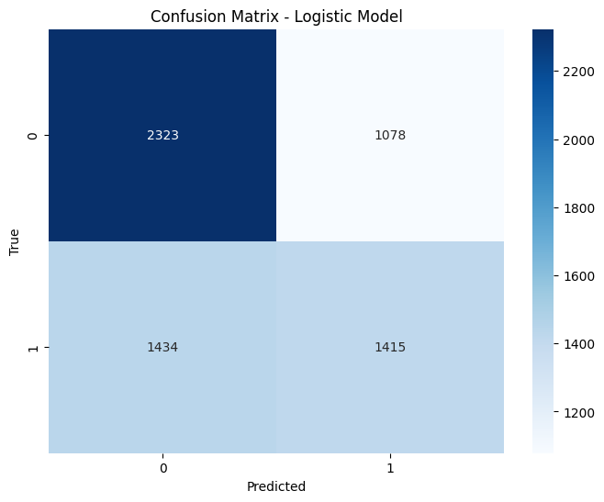
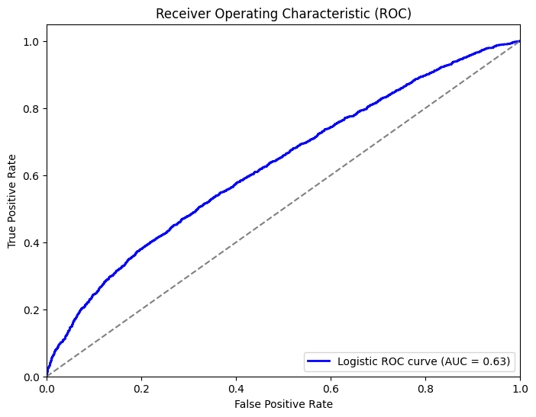
LOGISTIC REGRESSION - ROC CURVE AND HEATMAP

Slide 13
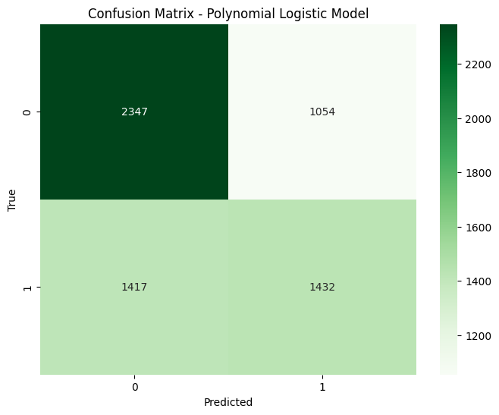
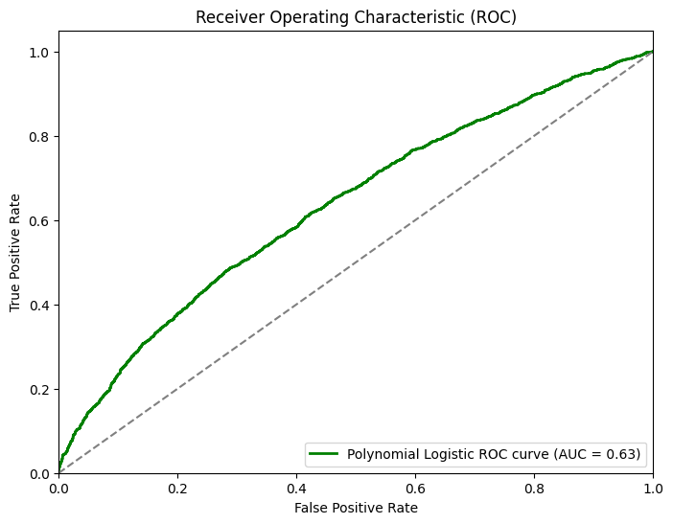
POLYNOMIAL LOGISTIC REGRESSION - ROC CURVE AND HEATMAP

Slide 14
SUPPORT VECTOR MACHINE (SVM)
 | Test Set |  |  |  | Training Set
 | Precision | Recall | F1-Score | Support | Precision | Recall | F1-Score | Support
Class 0 | 0.60 | 0.88 | 0.71 | 3401 | 0.60 | 0.88 | 0.71 | 10189
Class 1 | 0.67 | 0.29 | 0.40 | 2849 | 0.67 | 0.29 | 0.41 | 8561
Accuracy |  |  | 0.61 | 6250 |  |  | 0.61 | 18750
Macro Avg | 0.63 | 0.58 | 0.56 | 6250 | 0.64 | 0.59 | 0.56 | 18750
Weighted Avg | 0.63 | 0.61 | 0.57 | 6250 | 0.63 | 0.61 | 0.57 | 18750
SVM Model Training
Confusion Matrix and Classification Report
Model Evaluation on Training Data
Confusion Matrix Heatmap
Notes:
SVM Model Training:
Support Vector Machine (SVM) was trained with linear kernel, regularization parameter (C) was set to 1.0.
Evaluated model's predictive capabilities on test dataset (accuracy was around 0.60).
Confusion Matrix and Classification Report:
Confusion matrix provided breakdown of accurate and erroneous predictions. And Detailed classification report included precision, recall, F1-score, and support metrics for both classes.
Class 0: Precision 0.60, Recall 0.88, F1-score 0.71.
Class 1: Precision 0.67, Recall 0.29, F1-score 0.40.
Macro and weighted average F1-scores: 0.56 and 0.57, respectively.
Model Evaluation on Training Data:
Evaluated SVM model on training dataset (accuracy 0.61).
Similar class-specific metrics observed as in test set.
Receiver Operating Characteristic (ROC) Curve:
Plotted ROC curve to assess discriminatory capability.
AUC (area under the ROC curve) computed as 0.66.
Confusion Matrix Heatmap:
Heatmap of confusion matrix was visually represented.
It Provided insights into distribution of predicted vs. actual class labels.

Slide 15
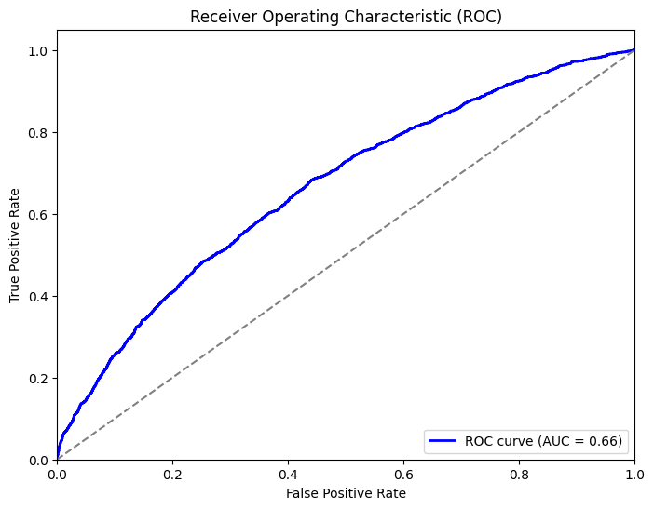
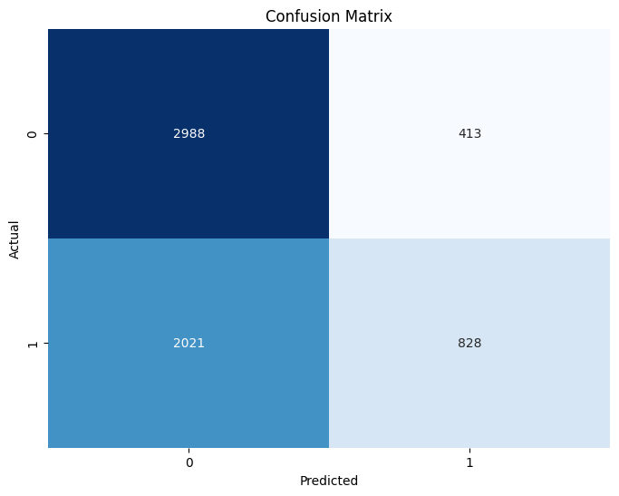
SVM - ROC CURVE AND HEATMAP

Slide 16
GRADIENT BOOSTING
 | Test Set |  |  |  | Training Set
 | Precision | Recall | F1-Score | Support | Precision | Recall | F1-Score | Support
Class 0 | 0.70 | 0.80 | 0.75 | 10189 | 0.64 | 0.72 | 0.68 | 3401
Class 1 | 0.72 | 0.60 | 0.65 | 8561 | 0.60 | 0.51 | 0.55 | 2849
Accuracy |  |  | 0.71 | 18750 |  |  | 0.62 | 6250
Macro Avg | 0.71 | 0.70 | 0.70 | 18750 | 0.62 | 0.61 | 0.61 | 6250
Weighted Avg | 0.71 | 0.71 | 0.71 | 18750 | 0.62 | 0.62 | 0.62 | 6250
Gradient Boosting Model Initialization and Training
Training Data Classification Report (Gradient Boosting)
Preprocessing for XGBoost Model
XGBoost Model Training and Testing
ROC Curve and AUC (XGBoost Model)
Confusion Matrix Visualization
Notes:
Gradient Boosting Model Initialization and Training:
Gradient Boosting model was initiated on dataset.
Configured hyperparameters were number of estimators (100), maximum depth (3), learning rate (0.80).
model's performance was evaluated on training data.
Training Data Classification Report (Gradient Boosting):
Classification report provided key metrics for class 0 and class 1 in training dataset.
Class 0: Precision 0.70, Recall 0.80, F1-score 0.75, Support 10189.
Class 1: Precision 0.72, Recall 0.60, F1-score 0.65, Support 8561.
Preprocessing for XGBoost Model:
We Replaced invalid characters in column names with underscores for data uniformity and accuracy.
XGBoost Model Training and Testing:
XGBoost model was instantiated with 150 estimators and maximum depth of 4.
Evaluated model on training and testing datasets.
Testing data results: Precision 0.64 (class 0), Recall 0.72 (class 0), F1-score 0.68 (class 0), Support 3401.
Precision 0.60 (class 1), Recall 0.51 (class 1), F1-score 0.55 (class 1), Support 2849.
Testing accuracy: 0.62, Macro average F1-score: 0.61, Weighted average F1-score: 0.62.
ROC Curve and AUC (XGBoost Model):
Visualized ROC curve to showcase model's class discrimination across probability thresholds. Area under the ROC curve (AUC): was 0.66, indicating moderate discrimination capabilities.
Confusion Matrix Visualization: was also generated for XGBoost model's predictions.
It Highlighted true positives, true negatives, false positives, and false negatives and Facilitated intuitive understanding of model's predictive patterns.

Slide 17

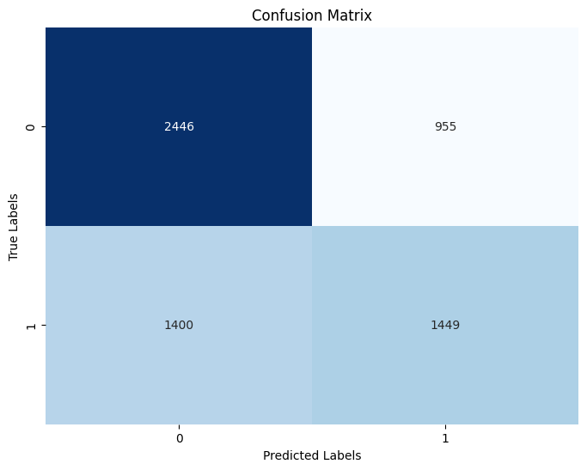
GRADIENT BOOSTING - ROC CURVE AND HEATMAP

Slide 18
GAUSSIAN NAIVE BAYES MODEL
 | Test Set |  |  |  | Training Set
 | Precision | Recall | F1-Score | Support | Precision | Recall | F1-Score | Support
Class 0 | 0.63 | 0.73 | 0.67 | 3401 | 0.62 | 0.72 | 0.67 | 10189
Class 1 | 0.60 | 0.48 | 0.53 | 2849 | 0.59 | 0.47 | 0.52 | 8561
Accuracy |  |  | 0.62 | 6250 |  |  | 0.61 | 18750
Macro Avg | 0.61 | 0.60 | 0.60 | 6250 | 0.60 | 0.60 | 0.59 | 18750
Weighted Avg | 0.61 | 0.62 | 0.61 | 6250 | 0.60 | 0.61 | 0.60 | 18750
Gaussian Naive Bayes Model Initialization and Training
Performance Evaluation on Training and Testing Data
Training Data Classification Report (Gaussian Naive Bayes)
Testing Data Classification Report (Gaussian Naive Bayes)
ROC Curve and AUC (Gaussian Naive Bayes Model)
Confusion Matrix Visualization
Notes:
Gaussian Naive Bayes Model was Initialized and trained Gaussian Naive Bayes model on dataset.
Performance Evaluation on Training and Testing Data:
Assessed model's performance on both training and testing datasets.
Generated detailed classification reports for class 0 and class 1 in each dataset.
Training Data Classification Report (Gaussian Naive Bayes):
Class 0: Precision 0.62, Recall 0.72, F1-score 0.67.
Class 1: Precision 0.59, Recall 0.47, F1-score 0.52.
Overall training accuracy: 0.61, Macro average F1-score: 0.59, Weighted average F1-score: 0.60.
Testing Data Classification Report (Gaussian Naive Bayes):
Class 0: Precision 0.63, Recall 0.73, F1-score 0.67.
Class 1: Precision 0.60, Recall 0.48, F1-score 0.53.
Overall testing accuracy: 0.62, Macro average F1-score: 0.60, Weighted average F1-score: 0.61.
ROC Curve and AUC (Gaussian Naive Bayes Model):
Generated ROC curve to illustrate model's discrimination capacity.
Area under the ROC curve (AUC): 0.64, reflecting model's ability to distinguish between classes.
Confusion Matrix Visualization:
Created confusion matrix for visualizing model's prediction outcomes.
Displayed true positives, true negatives, false positives, and false negatives.
Enhanced understanding of model's predictive performance through visual representation.

Slide 19
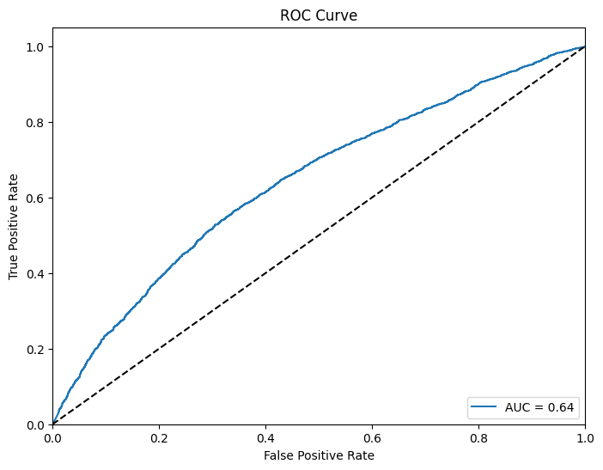
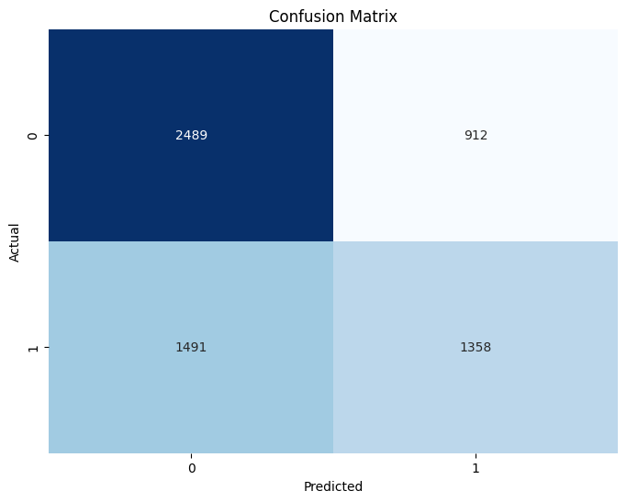
NAIVE BAYES - ROC CURVE AND HEATMAP

Slide 20
K-NEAREST NEIGHBORS
 | Test Set |  |  |  | Training Set
 | Precision | Recall | F1-Score | Support | Precision | Recall | F1-Score | Support
Class 0 | 0.59 | 0.64 | 0.61 | 3401 | 0.72 | 0.78 | 0.75 | 10189
Class 1 | 0.52 | 0.46 | 0.49 | 2849 | 0.71 | 0.64 | 0.67 | 8561
Accuracy |  |  | 0.56 | 6250 |  |  | 0.72 | 18750
Macro Avg | 0.55 | 0.55 | 0.55 | 6250 | 0.71 | 0.71 | 0.71 | 18750
Weighted Avg | 0.56 | 0.56 | 0.56 | 6250 | 0.72 | 0.72 | 0.71 | 18750
K-Nearest Neighbors (KNN) Model Training
Performance Assessment on Training and Testing Data
Training Set KNN Model Performance
Testing Set KNN Model Performance
ROC Curve and AUC Analysis
Confusion Matrix Visualization
Notes:
K-Nearest Neighbors (KNN) Model Training:
Trained K-Nearest Neighbors (KNN) model using scaled training data.
Considered five nearest neighbors for predictions.
Performance Assessment on Training and Testing Data:
Evaluated KNN model's performance on training and testing datasets.
Provided insights into model's generalization and predictive capabilities.
Training Set KNN Model Performance:
Achieved training accuracy of approximately 0.72.
Balanced trade-off between precision and recall observed.
Demonstrated effective identification of true positive cases while minimizing false negatives.
Testing Set KNN Model Performance:
Maintained testing accuracy around 0.56.
Assessed model's predictive capabilities on new, unseen instances.
Detailed breakdown of precision, recall, and F1-score metrics provided.
ROC Curve and AUC Analysis:
Utilized ROC curve to assess model's discrimination abilities.
Area Under the Curve (AUC) score of 0.58 quantified model's ability to distinguish between classes.
Confusion Matrix Visualization:
Generated confusion matrix for visualizing prediction outcomes.
Displayed true positives, true negatives, false positives, and false negatives.
Offered insights into prediction patterns and potential areas for improvement.

Slide 21
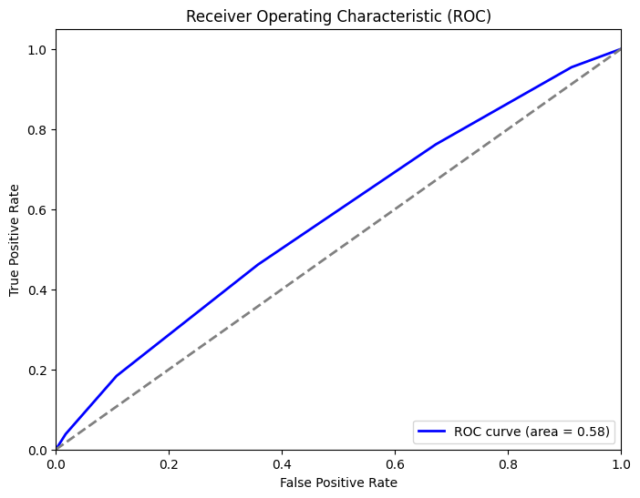
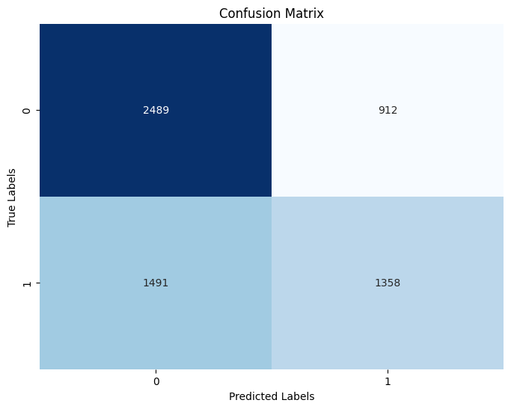
K-NN - ROC CURVE AND HEATMAP

Slide 22
NEURAL NETWORK
 | Test Set |  |  |  | Training Set
 | Precision | Recall | F1-Score | Support | Precision | Recall | F1-Score | Support
Class 0 | 0.62 | 0.64 | 0.63 | 3401 | 0.75 | 0.77 | 0.76 | 10189
Class 1 | 0.56 | 0.54 | 0.55 | 2849 | 0.71 | 0.70 | 0.71 | 8561
Accuracy |  |  | 0.59 | 6250 |  |  | 0.73 | 18750
Macro Avg | 0.59 | 0.59 | 0.59 | 6250 | 0.73 | 0.73 | 0.73 | 18750
Weighted Avg | 0.59 | 0.59 | 0.59 | 6250 | 0.73 | 0.73 | 0.73 | 18750
Neural Network Model Construction
Model Compilation and Training
Model Evaluation on Testing Set
Performance Evaluation on Training Set
ROC Curve and AUC Analysis
Confusion Matrix Visualization
Notes:
Neural Network Model Construction:
Constructed a neural network model using Keras library with TensorFlow backend.
Model architecture included input layer, two hidden layers with ReLU activation, and an output layer with sigmoid activation.
Model Compilation and Training:
Compiled model with 'adam' optimizer and 'binary_crossentropy' loss function and Trained model on scaled training data for 10 epochs with batch size of 32.
Utilized 10% validation split for monitoring training progress.
Model Evaluation on Testing Set:
trained model was evaluated on testing dataset.and testing dataset and predicted probabilities and applied threshold of 0.5 for classification were obtained.
classification report including precision, recall, F1-score, and accuracy metrics was also generated.
ROC Curve and AUC Analysis:
Created ROC curve using predicted probabilities to visualize class discrimination.
Calculated Area Under the Curve (AUC) score of 0.63 to quantify discriminatory power.
Confusion Matrix Visualization:
Generated confusion matrix to visually depict model's predictions against actual class labels.
Provided insights into distribution of true positives, true negatives, false positives, and false negatives.

Slide 23
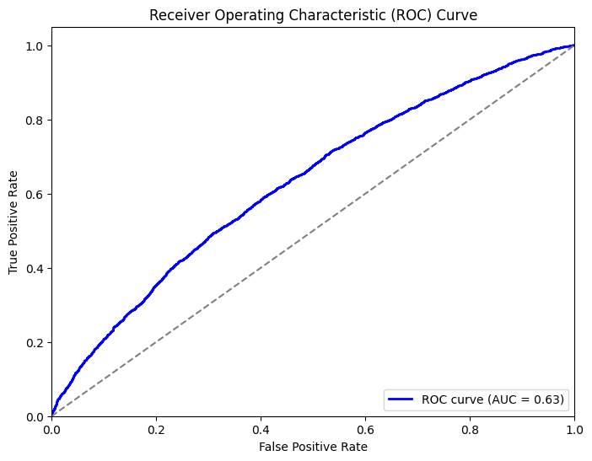
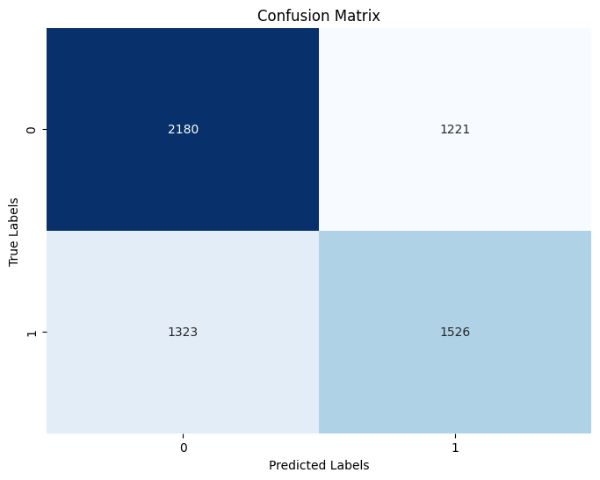
NEURAL NETWORK - ROC CURVE AND HEATMAP

Slide 24
RESULTS
Linear Regression: Accuracy: 60%, AUC: 0.63
Support Vector Machine (SVM): Accuracy: 60%, AUC: 0.66
Gradient Boosting: Balanced metrics, precision 0.70 (train), 0.64 (test)
Gaussian Naive Bayes: Moderate performance, precision 0.62 (train), 0.63 (test)
K-Nearest Neighbors (KNN): Varying precision/recall, AUC: 0.58
Neural Network: Competitive, precision 0.75 (train), 0.62 (test)
Conclusion: Gradient Boosting excelled with balanced metrics.
Notes:
Linear Regression Model: Achieved test set accuracy of around 0.60.
AUC of 0.63 demonstrated discriminatory capability.
Support Vector Machine (SVM): Attained test set accuracy of approximately 0.60.
However, Recall of 0.29 highlighted is a challenge in identifying positive class instances.
Gradient Boosting Model: had an Overall accuracy of 0.71 and AUC: at 0.66.
consistent performance across metrics was noted on both test and training sets.
Gaussian Naive Bayes Model: had an overall accuracy of 0.61, and AUC: was 0.64.
This model was moderate in its predictive capabilities.
K-Nearest Neighbors (KNN) Model:
Training set:
Precision: 0.72, Recall: 0.78.
Testing set:
Precision: 0.59, Recall: 0.64.
AUC of 0.58 suggested ability to distinguish classes.
Neural Network Model’s Accuracy: for training set was 0.73 and test set was 0.59.
AUC of 0.63 indicated discrimination capacity.
Conclusion:
Gradient Boosting model excelled with balanced metrics on training and testing sets.
Linear Regression model showcased competitive performance, particularly in accuracy and AUC.
Models displayed respective strengths in addressing classification task, aiding model selection.

Slide 25
CONCLUSIONS
Investigated machine learning models for patient readmission prediction.
Gradient Boosting exhibited highest predictive accuracy, balanced precision and recall.
Neural Network demonstrated competitive performance in predictive healthcare tasks.
Gradient Boosting's performance underscores its potential as a valuable healthcare tool.
Findings aid in proactive interventions, improving patient outcomes and resource allocation.

Slide 26
BENEFITS AND LIMITATIONS OF THE STUDY
BENEFITS
Gradient Boosting model achieved highest predictive accuracy.
Balanced precision and recall scores on training and testing datasets.
Neural Network model demonstrated competitive performance in healthcare predictions.
Comprehensive analysis of diverse variables enhanced predictive capabilities.
Potential for proactive interventions and tailored healthcare strategies.
LIMITATIONS
Absence of certain demographic and hospital-specific features.
Variability across different hospital settings introduced noise.
Dataset's encoded and de-identified nature restricted analysis.
Need for broader spectrum of hospital-related variables.
Potential bias due to dataset's disease-oriented focus.

Slide 27
REFERENCES
Cox, M., Panagides, J. C., Tabari, A., Kalva, S., Kalpathy-Cramer, J., & Daye, D. (2022). Risk stratification with explainable machine learning for 30-day procedure-related mortality and 30-day unplanned readmission in patients with peripheral arterial disease. PLoS ONE, 17(11), 1–18.
KWETCZER, L. A.,(2020). Hospital Readmission Risk Prediction Using Machine Learning.
Lin, Y.-W., Zhou, Y., Faghri, F., Shawl, M. J., & Campbell, R. H. (2019). Analysis and prediction of unplanned intensive care unit readmission using recurrent neural networks with long short-term memory. PLOS ONE, 14(7), e0218942.
Matheny, ME, Ricket, I, Goodrich, CA, Shah, RU, Stabler, ME, Perkins, AM, Dorn, C, Denton, J, Bray, BE, Gouripeddi, R, Higgins, J, Chapman, WW, MacKenzie, TA, Brown, JR. (2021). Development of Electronic Health Record-Based Prediction Models for 30-Day Readmission Risk Among Patients Hospitalized for Acute Myocardial Infarction.
Riester, M. R., McAuliffe, L., Collins, C., & Zullo, A. R. (2021). Development and validation of the Tool for Pharmacists to Predict 30-day hospital readmission in patients with Heart Failure (ToPP-HF). American Journal of Health-System Pharmacy, 78(18), 1691–1700.
Saha, P., Sircar, R., & Bose, A. (2021). Using hospital Admission, Discharge & Transfer (ADT) data for predicting readmissions. Machine Learning with Applications.
Welvaars, K., van den Bekerom, M. P. J., Doornberg, J. N., van Haarst, E. P., OLVG Urology Consortium, van der Zee, J. A., van Andel, G. A., Lagerveld, B. W., Hovius, M. C., Kauer, P. C., & Boevé, L. M. S. (2023). Evaluating machine learning algorithms to Predict 30-day Unplanned REadmission (PURE) in Urology patients. BMC Medical Informatics & Decision Making, 23(1), 1–13.
Yujuan Shang, Kui Jiang, Lei Wang, Zheqing Zhang, Siwei Zhou, Yun Liu, Jiancheng Dong, & Huiqun Wu. (2021). The 30-days hospital readmission risk in diabetic patients: predictive modeling with machine learning classifiers. BMC Medical Informatics and Decision Making, 21(S2), 1–11.

Slide 28
THANK YOU

